Slide 1

Object-oriented programming (oop) concepts in python
Name: Patil Kruti

Slide 2

Agenda
What is OOP? Why do we use it?
Core OOP Concepts:
Classes and Objects
Attributes and Methods
Encapsulation
Inheritance
Polymorphism
Abstraction (briefly)
Benefits of OOP

Slide 3

What is OOP? Why do we use it?
What is OOP(Object-Oriented Programming )?
A programming paradigm based on the concept of "objects.“
Objects can contain data (attributes) and code (methods).
Focuses on modularity, reusability, and maintainability.
Analogy: Think of real-world objects – a car has properties (color, make) and actions (accelerate, brake).
Why do we use it?
Modularity: Break down complex problems into smaller, manageable units.
Reusability: Write code once and reuse it in different parts of your application or across projects.
Maintainability: Easier to debug, update, and extend code.
Scalability: Well-designed OOP systems can grow and adapt to new requirements.
Collaboration: Easier for multiple developers to work on different parts of a project simultaneously.

Slide 4
Real-World OOP Example
Vehicle (Base Class)
Class | Attributes | Inherits From
Vehicle | make, model, year | -
Car | num_doors | Vehicle
Truck | payload_capacity | Vehicle
Motorcycle | has_sidecar | Vehicle
Car
Truck
Motorcycle

Slide 5


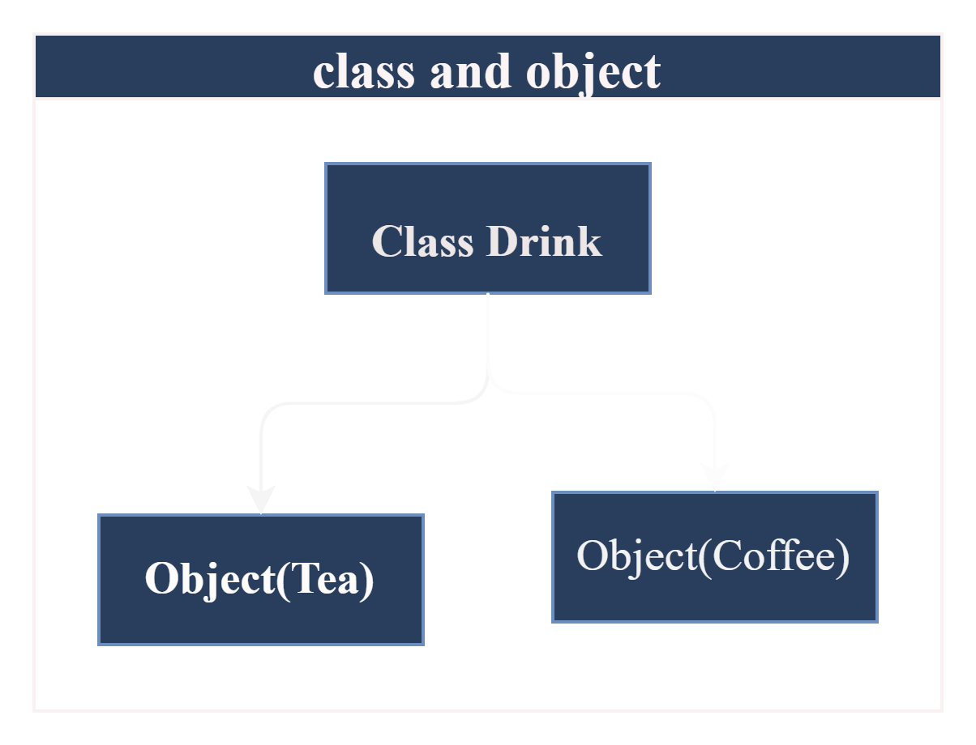
Core OOP Concepts:
Classes and objects
Class: A blueprint for creating objects. It defines a set of attributes and behaviors (methods).
Object: An instance of a class. It represents a specific entity with state and behavior.

Slide 6


Attributes and Methods
Methods:
Functions defined within a class.
Operate on the object's data.
The first parameter is always self, referring to the instance.
Attributes:
Variables that store data associated with an object.
Can be instance variables (unique to each object) or class variables (shared among all objects).

Slide 7
Encapsulation
Encapsulation is one of the fundamental concepts in object-oriented programming (OOP). Encapsulation in Python is the process of wrapping up variables and methods into a single entity. In programming, a class is an example that wraps all the variables and methods defined inside a single unit.
Bundling data and methods that operate on that data within a class.
Hides internal implementation details, exposing only necessary interfaces.
Example:
ATM doesn’t allow direct access to cash storage, only through controlled methods..

Slide 8
Inheritance
Inheritance is a feature of OOP that allows a class (child/derived class) to reuse the properties and methods of another class (parent/base class).
It promotes code reusability and creates a hierarchical relationship between classes.
Type of Inheritance:
Single Inheritance → One parent, one child
Multilevel Inheritance → Chain of classes (Grandparent → Parent → Child)
Multiple Inheritance → One child inherits from multiple parents
Hierarchical Inheritance → Multiple children inherit from the same parent
Hybrid Inheritance → Combination of above types

Slide 9
Type of Inheritance:
Single Inheritance → One parent, one child
Code:
class Animal: # Parent Class
def speak(self):
print("Animal speaks")
class Dog(Animal): # Child Class
def bark(self):
print("Dog barks")
d = Dog()
d.speak() # Inherited from Animal
d.bark() # Defined in Dog
Animal
Dog

Slide 10
2. Multilevel Inheritance
Code:
class Grandparent:
def house(self):
print("Grandparent has a house")
class Parent(Grandparent):
def car(self):
print("Parent has a car")
class Child(Parent):
def bike(self):
print("Child has a bike")
c = Child()
c.house() # from Grandparent
c.car() # from Parent
c.bike() # from Child
Grandparent
Parent
Child

Slide 11
3.Multiple Inheritance → One child inherits from multiple parents
Code:
class Mother:
def skills_mother(self):
print("Cooking skills")
class Father:
def skills_father(self):
print("Driving skills")
class Child(Mother, Father):
def skills_child(self):
print("Programming skills")
c = Child()
c.skills_mother()
c.skills_father()
c.skills_child()
Mother
Father
Child

Slide 12
4. Hierarchical Inheritance → Multiple children inherit from the same parent
Code:
class Parent:
def family_name(self):
print("Family: Patel")
class Child1(Parent):
def hobby(self):
print("Hobby: Traveling")
class Child2(Parent):
def hobby(self):
print("Hobby: Cricket")
c1 = Child1()
c2 = Child2()
c1.family_name() # Inherited
c2.family_name() # Inherited
Parent
Child1
Child2

Slide 13
5. Hybrid Inheritance → Combination of above types
Code:
class A:
def method_a(self):
print("Method A")
class B(A):
def method_b(self):
print("Method B")
class C(A):
def method_c(self):
print("Method C")
class D(B, C):
def method_d(self):
print("Method D")
d = D()
d.method_a() # From A
d.method_b() # From B
d.method_c() # From C
d.method_d() # From D
A
B
C
D

Slide 14
Polymorphism in Python
Definition: Polymorphism means “many forms”. It allows the same method name to be used for different types (classes), with different behaviors.
Type of Polymorphism:
Method Overloading
Method Overriding

Slide 15
Method Overloading
Code:
# Creating
classclass Multiplication:
def mul(self, x, y=1):
return x * y
# Method overloading
Multiply = Multiplication()print(Multiply.mul(4)) # Outputs: 4 (defaults to 1 for the second argument)print(Multiply.mul(4, 5)) # Outputs: 20

Slide 16
Method Overriding
Code:
class Animal:
def speak(self):
print("Animal speaks")
class Dog(Animal):
def speak(self): # Overriding parent method
print("Dog barks")
a = Animal()
d = Dog()
a.speak() # Animal speaks
d.speak() # Dog barks (overridden)

Slide 17
Comparison Table
Feature | Method Overloading | Method Overriding
Definition | Same method name, different parameters | Same method name, same parameters, different class
Where | Within the same class | Across parent & child classes
Python Support | Simulated (using default args / *args) | Fully supported
Example | add(2,3) vs add(2,3,4) | Animal.speak() vs Dog.speak()

Slide 18
Abstraction
Definition: Abstraction is the process of hiding implementation details and showing only the essential features of an object.
It helps simplify complex systems.
Achieved in Python using abstract classes and the abc module.
Abstract classes cannot be instantiated; they serve as a blueprint for other classes.
“from abc import ABC, abstractmethod”

Slide 19
Code:
from abc import ABC, abstractmethod
class Shape(ABC): # Abstract Class
@abstractmethod
def area(self):
pass
class Circle(Shape): # Concrete Class
def __init__(self, radius):
self.radius = radius
def area(self):
return 3.14 * self.radius * self.radius
# Usage
c = Circle(5)
print(c.area()) # 78.5

Slide 20
Benefits of OOP
Modularity – Code is divided into classes/objects, making it easier to organize.
Reusability – Inheritance allows reuse of existing code without rewriting.
Maintainability – Changes in one part of the program are easier to manage.
Abstraction – Hides unnecessary details and shows only what is needed.
Encapsulation – Protects data by controlling access through methods.
Polymorphism – Same method name can work differently for different objects.
Scalability – Makes it easier to build and expand large applications.

Slide 21
Thank You

